Slide 1

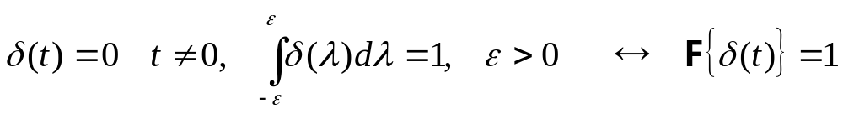
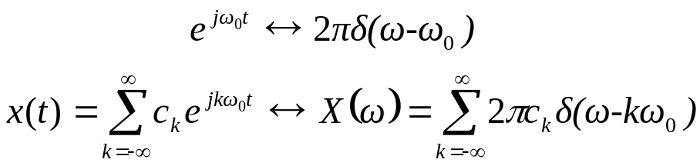
Generalized Fourier Transform
Consider a DC or constant signal:
Compute its Fourier Transform:
Unfortunately, the limit is not finite, and the integral does not converge.
Consider an alternate approach based on an impulse function:
Apply the duality property:
This is known as the Generalized Fourier transform. It allows us to extend the Fourier transform to some additional useful signals such as periodic signals:
The Fourier transform of a periodic signal is a train of impulse functions (and is a line spectrum).

Slide 2
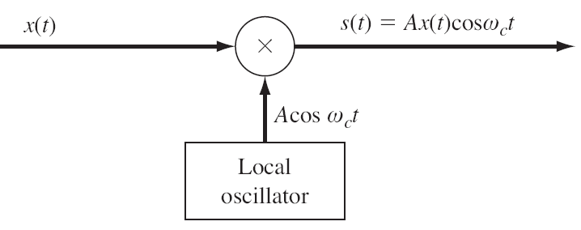
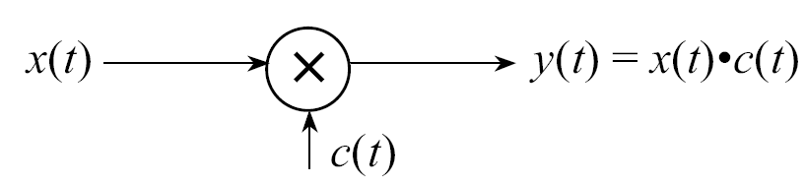
The Concept of Modulation
The electromagnetic spectrum is the most expensive “real estate” in the world. Hence, we would like to make as efficient use of it as possible (e.g., time and frequency domain multiplexing).
It is more efficient (e.g., less power for a given SNR) to transmit signals at higher frequencies.
Modulation: send multiple signals
through the same medium (e.g. air,
cables, fibers) by simply shifting
them to different places in the
spectrum.
Amplitude Modulation: carry the
information in the amplitude of the
signal; use a sinusoidal carrier, c(t).
Angle Modulation: alternate approach in which the signal is carried in the frequency or phase of the carrier signal (frequency and phase modulation).
Many other forms of modulation including pulse-amplitude modulation (PAM), pulse-width modulation (PWM), code division multiple access (CDMA) and spread spectrum. These techniques are typically studied in an introductory course in communications theory.

Slide 3
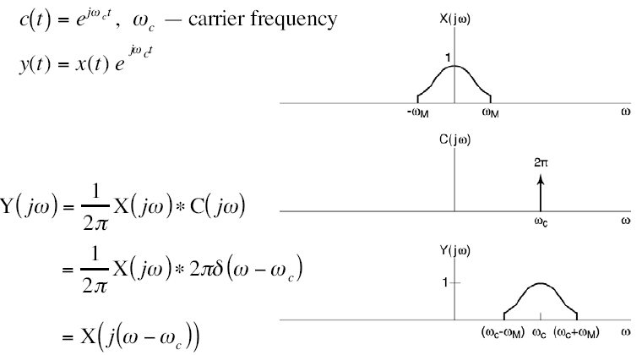
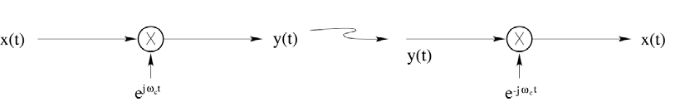
Amplitude Modulation Using a Complex Exponential
Modulation:
Demodulation:
Notes:
]i=k,

Slide 4
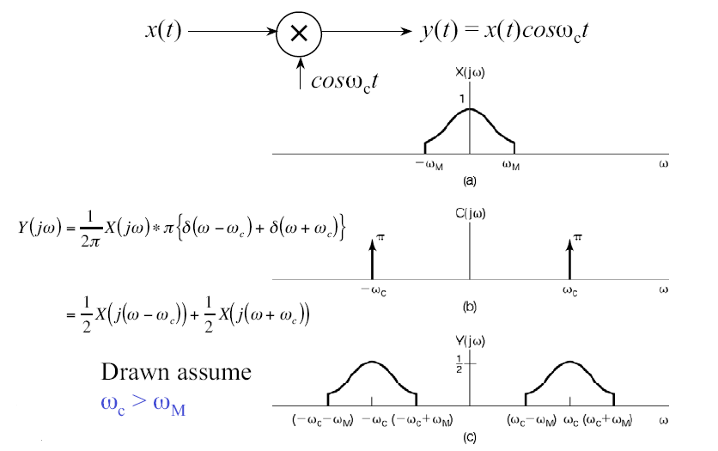
Amplitude Modulation Using a Sinusoid
Notes:
]i=k,

Slide 5
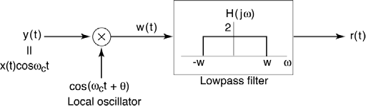
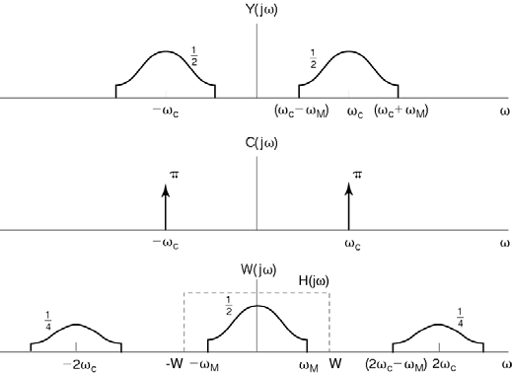
Synchronous Demodulation of Sinusoidal AM
Assumptions:
θ = 0 (for now),
Local oscillator is synchronized with the carrier.
In practice, synchronization is achieved using a phase-locked loop (PLL).
Notes:
]i=k,

Slide 6
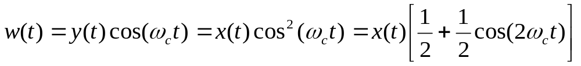
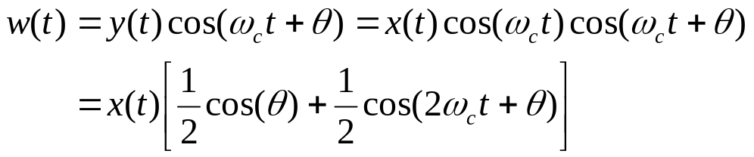
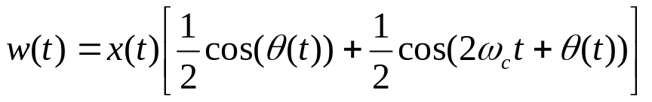
Synchronous Demodulation in the Time Domain
We can easily derive the properties of the demodulated signal:
The low-pass filter removes the high-frequency replica of x(t), leaving only the “baseband” component.
Suppose there is a phase difference between the transmitter and the receiver:
The mismatch in phase appears as a scale factor that can be ignored.
If there is a time-varying phase difference (due to drift):
If the phase difference varies slowly in time, the net result is simply a time-varying amplitude change, which distorts the signal (slightly).
What happens if the receiver is exactly 90° out of phase?
Notes:
]i=k,

Slide 7
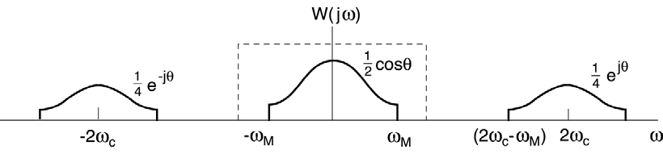
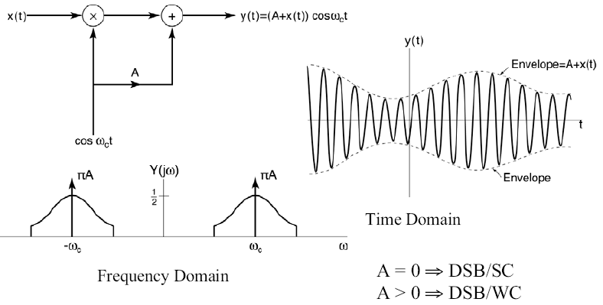

Asynchronous Demodulation
Consider the spectrum of our modulation signal:
Problems if the transmitter and receiver are exactly 90° out of phase.
Alternative: Asynchronous
modulation includes the
carrier in the output and
ensures the envelope
of the modulated carrier
contains the information.
The carrier must be much
higher in frequency than
the signal:
Notes:
]i=k,

Slide 8
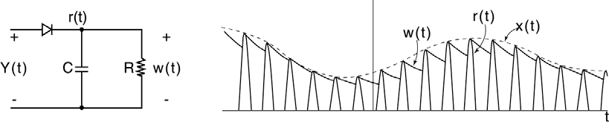
Implementation of an Asynchronous Demodulator
AM modulation was popular because of the ease with which it could be demodulated:
However, for this to work, the envelope function must be positive (A+x(t) > 0).
We pay a price in efficiency: more power must be used to guarantee this condition is true.
Notes:
]i=k,

Slide 9
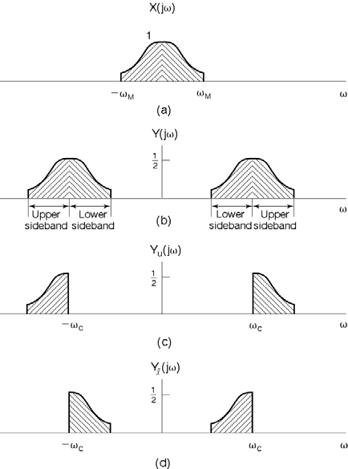
Double-Sideband Vs. Single-Sideband Modulation
Since x(t) and y(t) are real, from conjugate symmetry, both lower sideband (LSB) and upper sideband (USB) signals carry exactly the same information.
Double-sideband (DSB) occupies 2M bandwidth in ω > 0, even though all the information is contained in M.
Single-sideband (SSB) occupies M bandwidth in ω > 0.
Of course, SSB requires slightly more complicated hardware, so it was originally only used in applications where bandwidth was very limited (e.g., transcontinental telephone lines).
Analog television signals, which are being obsoleted in February 2009, use a variant of SSB.
Notes:
]i=k,

Slide 10
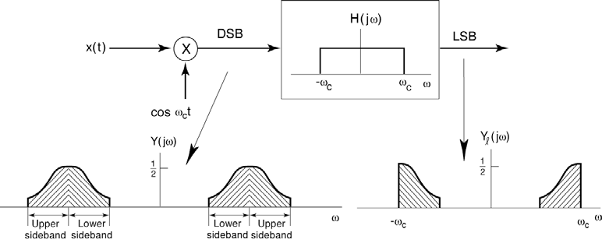
Single-Sideband Modulation
Notes:
]i=k,

Slide 11
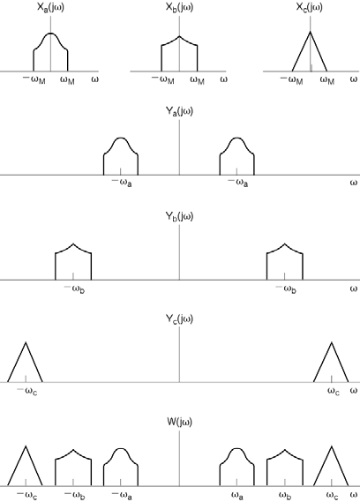
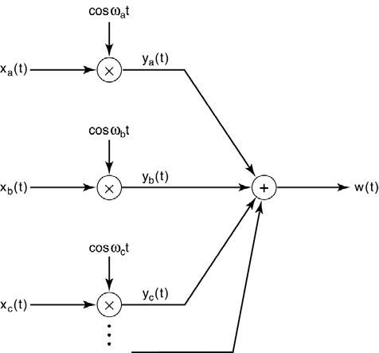
Frequency Division Multiplexing
Used in many communications systems including broadcast radio and cell phones.
Notes:
]i=k,

Slide 12
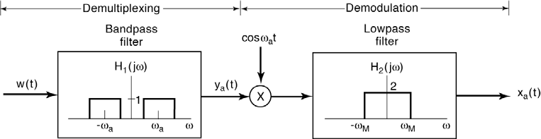
Demultiplexing and Demodulation
Recall to recover one channel (e.g., radio station) from a multiplexed signal, we must first bandpass filter the multiplexed signal, and then demodulate it:
However, the channels must not overlap for this to work. Fortunately, this is an important role played by the FCC (in the U.S.) – management of the electromagnetic spectrum.
It is difficult to design a highly selective bandpass filter with a tunable center frequency.
A better solution is the superheterodyne receiver: downconvert all channels to a common intermediate frequency. “The advantage to this method is that most of the radio's signal path has to be sensitive to only a narrow range of frequencies. Only the front end (the part before the frequency converter stage) needs to be sensitive to a wide frequency range.” (Wiki)

Slide 13
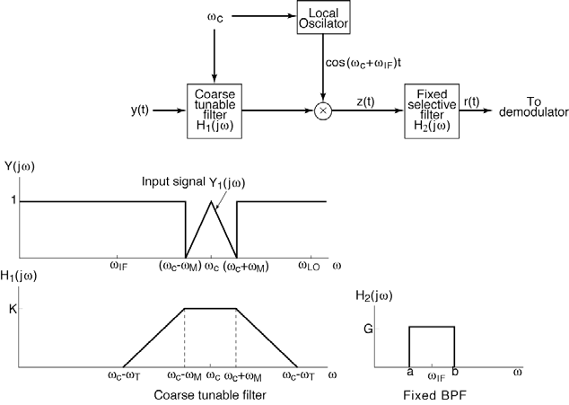
The Superheterodyne Receiver
AM Band: 535 – 1605 kHz
FCC-mandated
IF Frequency: 455 kHz
Principle: Down convert the received signal from ω_{c} to ω_{IF} using a coarse tunable bandpass filter. Use a sharp, fixed bandpass filter at ω_{IF} to demodulate the remaining signal and remove remnants of the other channels that pass through the initial coarse filter.

Slide 14
Summary
Introduced the Generalized Fourier transform.
Demonstrated its use on periodic signals (e.g., Fourier series).
Introduced the concept of modulation.
Discussed amplitude and angle modulation.
Discussed modulation and demodulation of AM signals.
Introduced both a synchronous and asynchronous approach to demodulation.
Introduced techniques used in a variety of common communications systems including single-sideband and double-sideband modulation, and frequency division multiplexing.

